Slide 1
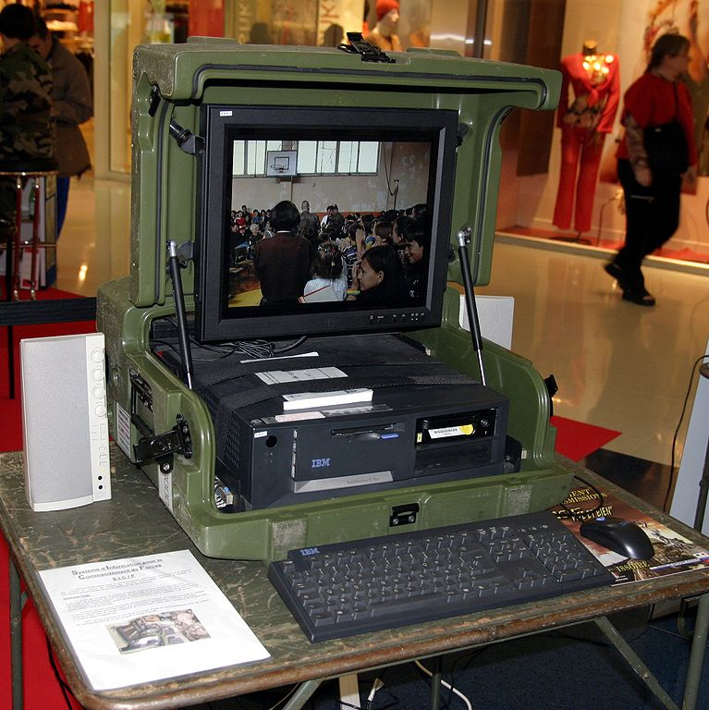
Mobile and Desktop Applications with C♯
Rasmus Lystrøm
Associate Professor
ITU
This Photo by Unknown Author is licensed under CC BY-SA

Slide 2

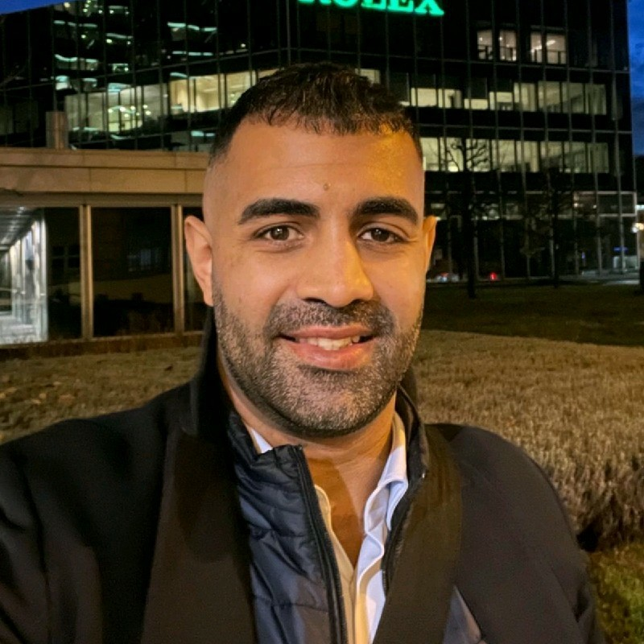
Guest Lecture
Ali Reza Farahnak
Global Senior Customer Engineer
Mobile Application Development with C♯
This Photo by Unknown Author is licensed under CC BY

Slide 3

Agenda
Mobile and Desktop Applications (by Ali)
MVVM Architectural Pattern
Xamarin.Forms
.NET Multi-platform App UI (MAUI)
Upgrading .NET applications
Blazor follow-up
Windows Applications
Windows Forms (WinForms)
Windows Presentation Foundation (WPF)
This Photo by Unknown Author is licensed under CC BY-NC-ND

Slide 4
Upgrading .NET Applications

Slide 5
The Tools
dotnet tool install --global upgrade-assistant
dotnet tool install --global try-convert

Slide 6
Update your stack
Get the latest .NET SDK: https://dot.net/
dotnet tool list --global
dotnet tool update --global dotnet-ef

Slide 7
Upgrading .NET Applications
Demo

Slide 8
Thank You

